Slide 1

Bookstore Management: A Full-Stack Web Solution
Revolutionizing bookstore operations through intelligent digital transformation.
Team 8, Priti Mondal Id: 2418076
Cohort code: VIRINTADM25JFSA001

Slide 2

Introduction
From Manual Chaos to Digital Clarity
Managing a bookstore isn’t simple – it involves juggling inventory, customers, sales, and reporting, and manual methods turn this into chaos.
Our solution brings digital clarity with a Full Stack Book Store Management Application that automates operations, improves accuracy, and delivers a seamless experience.

Slide 3





Key Objectives: Powering Your Bookstore's Success
Simplify Inventory Management
Secure Authentication
Streamline Sales & Orders
Robust JWT-based user authentication and role-based access control.
Automate order processing from cart to fulfillment for enhanced customer experience.
Efficiently add, update, and track books with real-time stock visibility.
Actionable Insights
Enhanced Discovery
Generate comprehensive sales reports and analytics to drive business decisions.
Advanced search and personalized recommendations for customers.

Slide 4
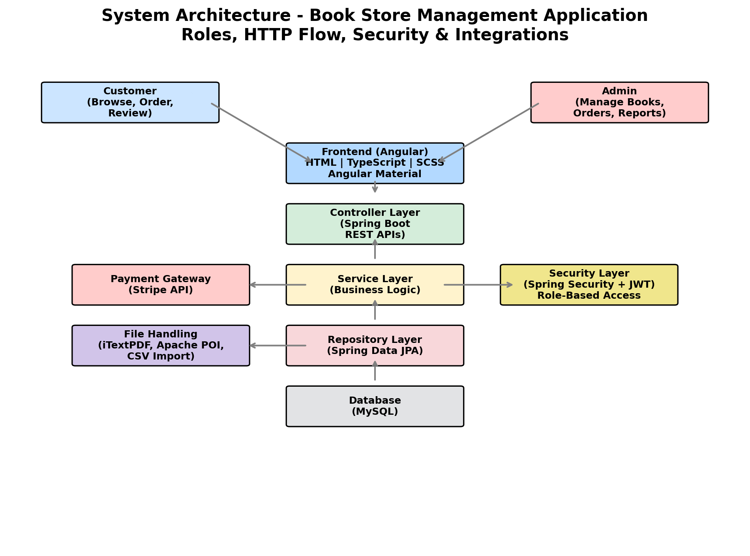




Robust Architecture for Reliability
Our solution is built on a modern, layered architecture ensuring scalability, security, and maintainability.
Frontend
Angular + Tailwind CSS:
Dynamic and responsive user interfaces.
Backend
Spring Boot:
Secure REST APIs, business logic, and integrations.
Database
MySQL:
Reliable and structured data storage with normalized schema.
Security
JWT + Role-based Authorization:
Protecting data and access.

Slide 5
Comprehensive System Overview
Core Modules
Technology Stack
Key Entities (ERD)
Inventory Management
Frontend: Angular, Tailwind CSS, Chart.js
Book, Category, User, Review, Cart, CartItem, Order, OrderItem, Payment
User Management
Sales & Orders
Backend: Java, Spring Boot, Spring Security, Spring Data JPA, JWT, iText, Stripe API
Reporting & Analytics
Relationships ensure data integrity and efficient querying.
Search & Recommendations
Database: MySQL
Tools: Git, Postman

Slide 6






Feature Highlights
Inventory Control
User Management
Add, update, delete books, bulk uploads, stock logs and low-stock alerts.
Secure registration, login, role-based access, and profile management and reviews
Sales & Orders
Reporting & Analytics
Cart, order placement, invoice generation and payment integration
Sales and inventory reports, PDF export, intuitive dashboard charts.
Search & Recommendations
Robust Security
Full-text search and filters, trending books, personalized recommendation and category-based suggestions.
JWT, BCrypt hashing, and centralized exception handling for data safety.

Slide 7

Agile Development & Workflow
Our development process embraced Agile methodologies to ensure flexibility, rapid iteration, and continuous delivery of value.
Sprint 0 – Project Setup
1
2
Sprint 1 – Inventory Management
Sprint 2 – User Management
3
4
Sprint 3 – Order Processing (Phase 1)
Sprint 5 – Order Processing (Phase 2) + Reporting
5
6
Sprint 6 – Integration
Sprint 7 – Finalization
7

Slide 8




Challenges Addressed & Future Vision
Challenges & Solutions
CORS errors while connecting frontend & backend
Authentication & role management (Admin vs User)
Solution: Enabled CORS in backend configuration and used proxy in frontend.
Solution: Implemented JWT-based authentication with role-based access control.
Database relationship handling (Books ↔ Orders, User ↔ Orders)
State management for cart & wishlist
Solution: Designed normalized schema and used JPA/Hibernate mappings effectively.
Solution: Used React Context API/Redux for consistent state handling across components.
Error handling & user feedback
Deployment difficulties (frontend & backend integration)
Solution: Added backend validations and frontend-friendly error messages.
Solution: Configured environment variables and deployed using a single server setup.
Future Advancements
AI-based Recommendations → Personalized book suggestions.
Payment Gateway Integration → Secure online transactions.
Review & Rating System → Enhance customer engagement.
Mobile App Version → Expand accessibility.
Analytics Dashboard → Track sales, popular books, and user behavior.
Cloud Scalability → Handle large traffic and global reach.

Slide 9

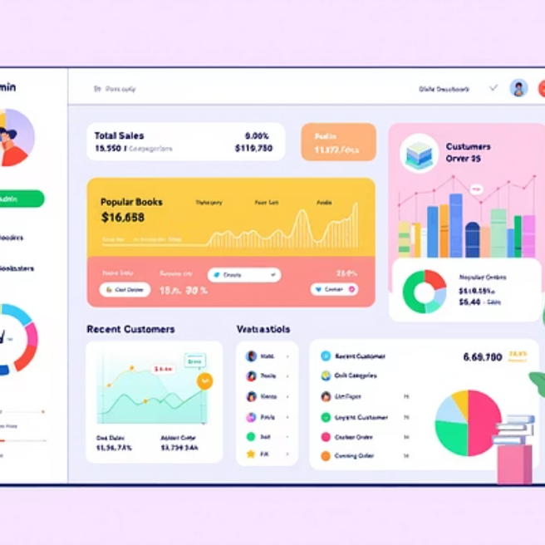

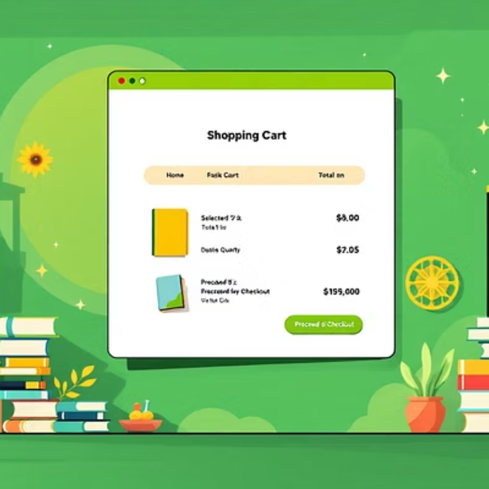


Application in Action: A Visual Tour

Slide 10




Conclusion: Your Bookstore, Digitally Empowered
100%
95%
Operational Efficiency: Automating daily tasks for maximum productivity.
Data Accuracy: Reducing manual errors through digitization.
98%
90%
Enhanced Security: Protecting sensitive data with robust measures.
Customer Satisfaction: Improving user experience with seamless features.

Slide 11

Thank You !

